Slide 1
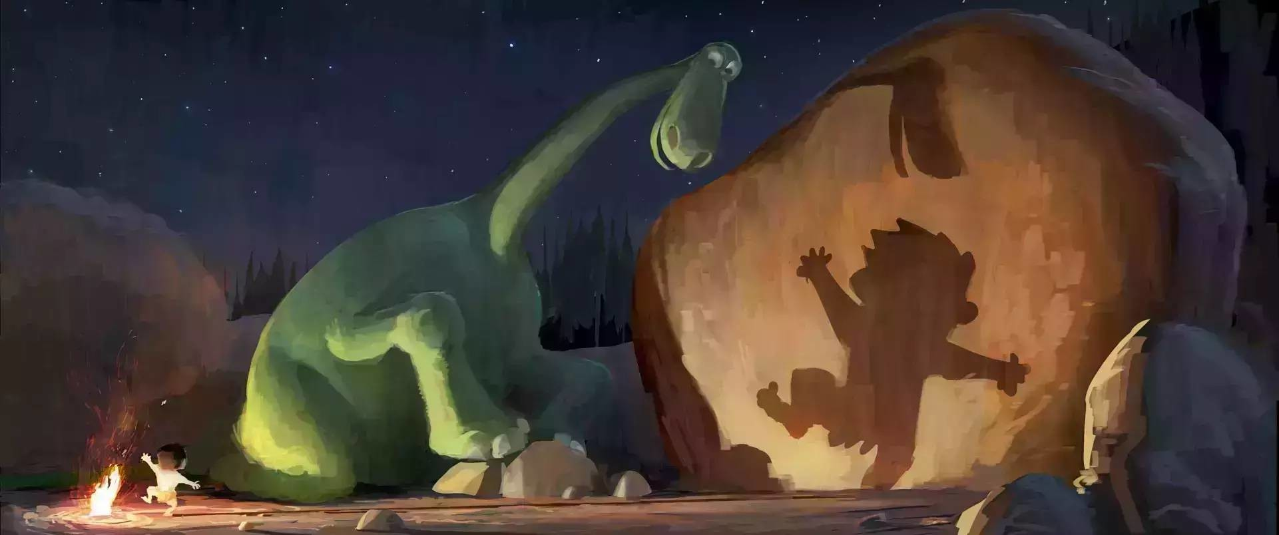
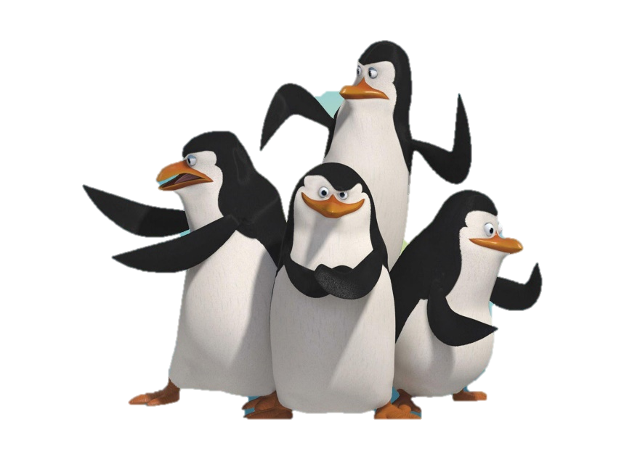
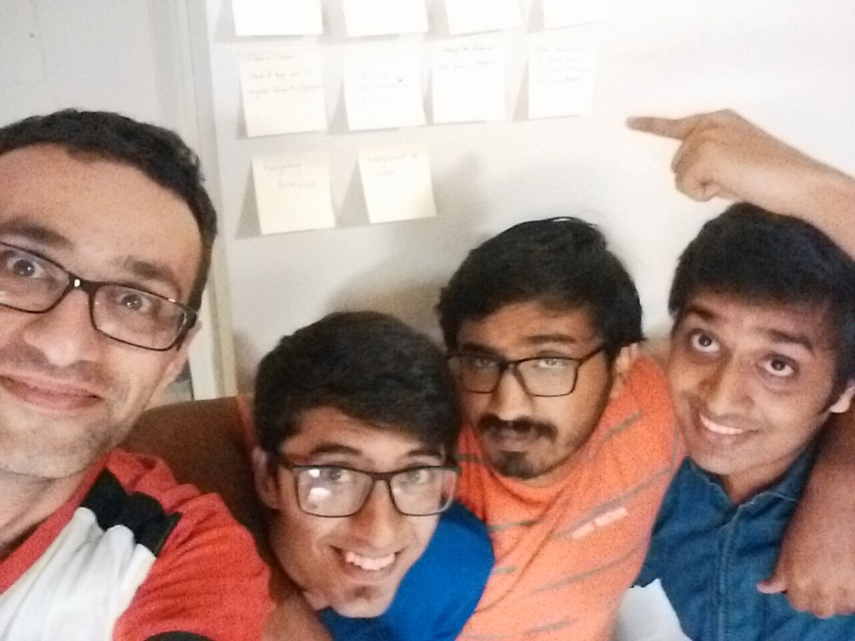
Software Development Class - IST 303 Midterm Presentation Professor Terry Ryan Gila Breath Camp
Team #Penguins:
Jemin Gohil (aka Kowalski)
Karthik Manjunath (aka Rico)
Rohan Sawant (aka Skipper)
Soheil Bouzari (aka Private)

Slide 2

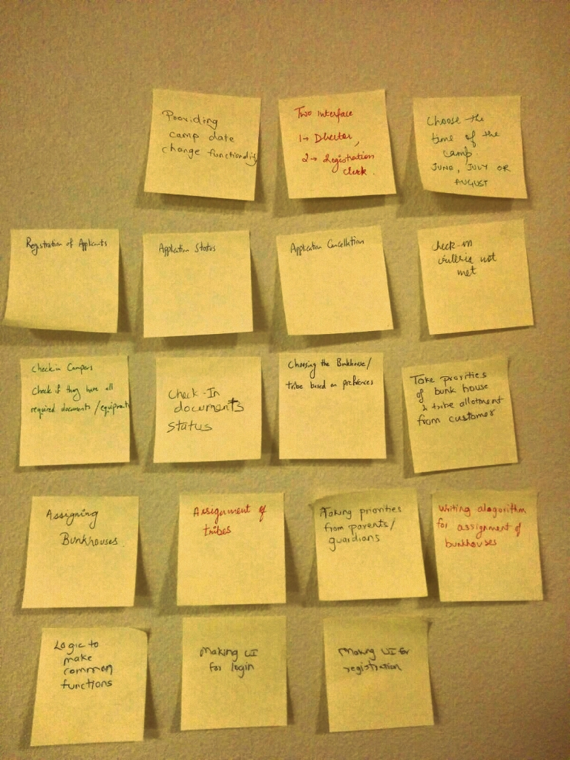
Gathering Requirements
Blueskying
Brainstorming
Role playing

Slide 3
Technologies
Blueskying

Slide 4
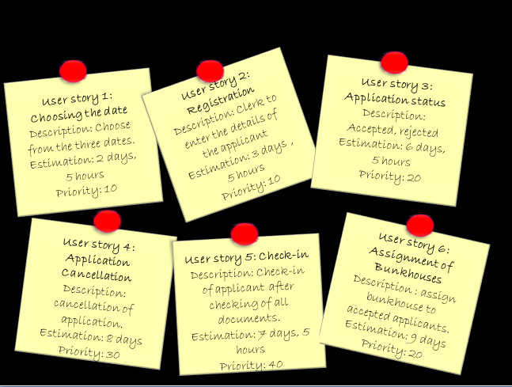
User Stories

Slide 5
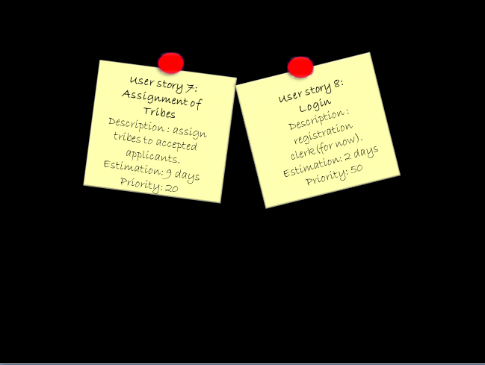
User Stories(Cont.)

Slide 6
Planning Poker
Start Date – 09/19/2016 End Date – 10/19/2016
Number of Iterations :3
Team Velocity : 0.40
Estimated Days of Work: 64
Number of Calendar days : 31
22 Workdays (31* 5/7)
Number of holidays by the developers: 2.50 Days
Number of Workdays left : 19.5 Days
Amount of work to be complete before due date= ( 19.5 * 0.40 * 4) = 31 Days
Days that could be deferred : 64 – 31 = 33 Days

Slide 7
Tasks/BigBoard
User Story 1: Choosing the date
Task
1. Making the date class (Entity) Making the CSV File | Soheil | 1 hr
2. Making the logic of choosing the date Connecting it to the CSV File | Rohan | 4 hrs
3. Connecting the choosing date logic to the UI | Karthik | 3 hrs
4. Testing the logic Testing the UI | Jemin | 1 day
5. Common functions | Rohan | 5 hrs
User Story 2: Registration
Task
1. Making the Applicant Class (Entity) Making the CSV File | Jemin/ Soheil | 2 hrs
2. Adding Transformations to the Applicant class | Jemin/ Soheil | 4 hrs
3. Making the logic for the Applicant class | Jemin/ Soheil | 3 hrs
4. Making the common functions for the Applicant Class | Rohan | 5 day
5. Connecting the Registration logic to the UI | Karthik | 3 hrs
6. Testing the logic, Testing the UI | Jemin | 1.5 days

Slide 8
Tasks/BigBoard(cont.)
User Story 3: Application status
Task
1. Creating the Common functions for reading/writing/updating the application status | Rohan | 5 hrs
2. Making the logic Reading from the file and adding constraints for Age, Registration, Date Windows, Check Clearing | Rohan | 2 days
3. Connecting to the UI | Karthik | 1 day
4. Testing the logic Testing the UI | Jemin/ Soheil | 3 days
User Story 5: Check-In
Task
1. Creating the Common functions for reading/writing/updating the Check-In | Rohan | 5 hrs
2. Making the logic for providing the CSV to the UI | Karthik | 1.5 days
3. Connecting the read data to the UI | Karthik | 1 day
4. Making the logic for moving data from UI to CSV | Rohan/ Karthik | 1 day
5. Testing the UI | Jemin/ Soheil | 3.5 days

Slide 9
Schedule/Velocity/Burnchart
Created based on initial estimates

Slide 10
Schedule/Velocity/Burnchart(cont.)
After Moving Two User Stories to the next milestone and bringing one up and Re-estimating, we got this one…
Boom, We are On track again..

Slide 11


Milestone 1.0
User story 1:
Choosing the date
Description: Choose from the three dates. 2 days 5hr
Priority: 10
User story 2:
Registration
Description: Clerk to enter the details of the applicant
3days 5hrs
Priority: 10
User story 3:
Application status
Description: Accepted, rejected
6 days 5 hrs
Priority: 20
User story 5:
Check-in
Description: Check-in of applicant after checking of all documents.
7days 5hrs
Priority: 40
Velocity

Slide 12
Version Control (Git)
https://github.com/karbmk/software_development_cgu
git add .
git commit –a –s
git push origin master
Merge conflicts:
git checkout <files creating conflict>

Slide 13
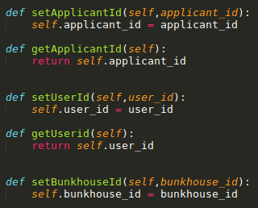


Refactoring: SRP
Creating objects with independent methods
The _<class>_ _<method>’s_ itself, The Applicant setApplicantId itself
Keeping the functions of each object

Slide 14




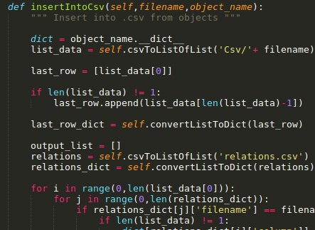
Refactoring: DRY
Creating a Common File for read/write/update/increment user id
CSV File

Slide 15
Codes/UI
Blueskying

Slide 16
Codes/UI(cont.)
Blueskying

Slide 17
Challenges
Everyone: Estimation of time for user stories
Rohan/Karthik :Understanding the testing module – unittest
Soheil: Balance the workload with other courses - Understanding some concepts as I was not familiar with
Jemin: Understanding the software development practices

Slide 18
Thank You

